Slide 1



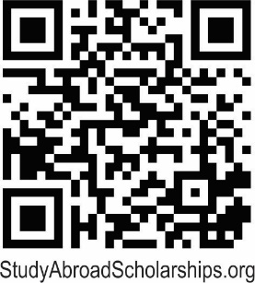
STUDY ABROAD
In 2025-2026
The Youth Exchange Scholarship
www.studyabroadscholarships.org
Valued at over $24,000: Room, board, tuition, and monthly stipend for a high school year abroad.
Have you ever dreamed of…
Traveling the world?
Living in another country?
Being fluent in another language?
The Youth Exchange Scholarship for one academic year covers room, board, tuition, and a monthly stipend. The student/family pays for airfare, medical insurance, personal and optional expenses.
The Youth Exchange Scholarships are made possible by the generosity of our Rotary partners overseas and local Rotary clubs. Qualified applicants must be ages 15-18 ½ at the time of departure.
For More Information Contact: Marsha Bassett, cell: 269-998-2829 Email: bassett@msu.edu or Margie Haas, cell: 269-838-3392, Email: haasmargie@gmail.com.
www.studyabroadscholarships.org

